Slide 1


Slide 2
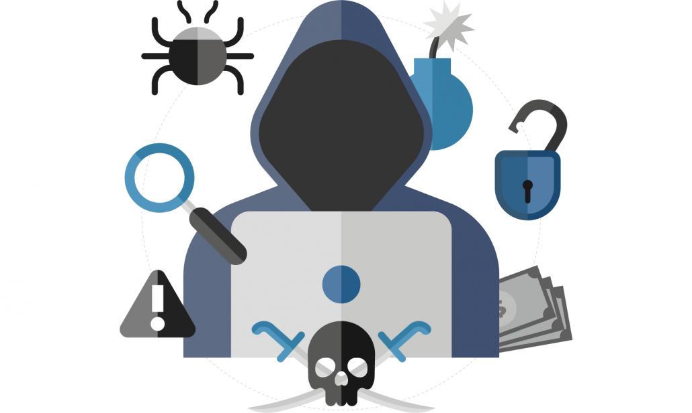

Common Phishing Tactics
Phishing: A Guide to Staying Safe Online
Phishing is a type of cybercrime where attackers attempt to steal your personal information, such as passwords, credit card details, and bank account numbers.
by Raghav Sharma

Slide 3

Recognizing Phishing Emails
Common Phishing Tactics
1
Spoofing
Attackers impersonate legitimate organizations to trick you into giving them your information.
2
Baiting
They entice you with offers that seem too good to be true, such as free gifts or discounts.
3
Pretexting
They create a convincing story to persuade you to give them your information.
4
Scare Tactics
They threaten you with consequences if you don't take action, such as account suspension or legal action.
Sender Address
Suspicious Links
Grammar and Spelling Errors

Slide 4
Recognizing Phishing Emails
Phishing Website Red Flags
Misspelled URLs
Sender Address
Suspicious Links
Grammar and Spelling Errors
Lack of Security Measures
Check if the sender's email address matches the organization's official address.
Hover your mouse over any links to see if the URL matches the intended destination.
Phishing emails often have grammatical errors and poor spelling, which are signs of a scam.
Request for Personal Information
Unprofessional Design

Slide 5
Phishing Website Red Flags
Phishing on Social Media
Misspelled URLs
Fake Profiles
Check the website address carefully for any typos or unusual characters.
Lack of Security Measures
Look for a padlock icon in the browser address bar and "https" at the beginning of the URL.
Suspicious Links
Request for Personal Information
Legitimate websites rarely ask for sensitive information such as your password or credit card details.
Unprofessional Design
Direct Messages
Phishing websites often have a poorly designed website with unprofessional graphics and layouts.

Slide 6




Protecting Yourself from Phishing
Phishing on Social Media
Fake Profiles
Attackers create fake profiles that mimic real people or organizations to gain your trust.
Suspicious Links
Be cautious about clicking on links shared in posts, comments, or messages, especially if they look unfamiliar or suspicious.
Direct Messages
Be wary of direct messages from unknown senders, especially if they ask for personal information or try to sell you something.

Slide 7

Reporting Phishing Attempts
Protecting Yourself from Phishing
Be Skeptical
1
Don't trust emails or messages that ask for your personal information or offer unrealistic deals.
Report Phishing Emails
2
Verify Information
If you receive a suspicious email or message, contact the organization directly to verify the request.
Use Strong Passwords
3
Create strong passwords that are unique for each of your online accounts.
Report Phishing on Social Media
4
Enable Two-Factor Authentication
This adds an extra layer of security by requiring you to enter a code from your phone or email when logging in.
Keep Your Software Updated
5
Regularly update your operating system and software to patch vulnerabilities.
Report Phishing Websites
6
Be Aware of Scams
Stay informed about the latest phishing scams and techniques.

Slide 8

Reporting Phishing Attempts
Consequences of Falling for Phishing
Report Phishing Emails
Most email providers have a "report spam" or "report phishing" button you can use to flag suspicious emails.
Report Phishing on Social Media
Report fake profiles or suspicious links to the social media platform's support team.
Report Phishing Websites
You can report phishing websites to the Internet Crime Complaint Center (IC3) or the Federal Trade Commission (FTC).

Slide 9




Best Practices for Phishing Prevention
Consequences of Falling for Phishing
Identity Theft
Attackers can use your stolen information to open credit cards, take out loans, or commit other crimes.
Financial Loss
They can drain your bank accounts, steal your credit card information, or make unauthorized purchases.
Data Breaches
They can access your sensitive information, such as medical records, tax returns, and other confidential documents.
Reputation Damage
Your online reputation could be damaged if your personal information is compromised.
Use Strong Passwords
Stay Informed
Enable Two-Factor Authentication
Keep Your Software Updated

Slide 10

Best Practices for Phishing Prevention
Resources for Further Learning
Use Strong Passwords
Stay Informed
Create unique, complex passwords for
each of your online accounts.
Stay up-to-date on the latest phishing
scams and techniques.
Enable Two-Factor Authentication
Keep Your Software Updated
This adds an extra layer of security by
requiring you to enter a code from your
phone or email when logging in.
Regularly update your operating system
and software to patch vulnerabilities.

Slide 11


Resources for Further Learning
The Federal Trade Commission (FTC) website has information about identity theft and phishing scams: https://www.ftc.gov/ The Internet Crime Complaint Center (IC3) website provides resources for reporting cybercrime: https://www.ic3.gov/ The Anti-Phishing Working Group (APWG) website offers information and best practices for combating phishing: https://www.apwg.org/

Slide 12


THANKYOU

